Slide 1


Administrator
Logged on
Bindows 7 Ultimate

Slide 2
Logging off…
Bindows 7 Ultimate

Slide 3
Restarting…
Bindows 7 Ultimate

Slide 5
eBox
Reboxing in this forever.
F10 - Startup options
DEL – Setup
F11 – View all hardware installed
_

Slide 7
Starting Bindows…
Copyright © 2017 BubbleSoft Corporation

Slide 9
Administrator
Bindows 7 Ultimate

Slide 10
Welcome
Bindows 7 Ultimate

Slide 11
Bindows 7
For testing purposes only. Build 7351

Slide 12

Computer
Bindows 7
For testing purposes only. Build 7351

Slide 13
Computer
X
Coming soon features here! :D
Computer
View the system information
View the Binver
Go to control panel
Bindows 7
For testing purposes only. Build 7351

Slide 14
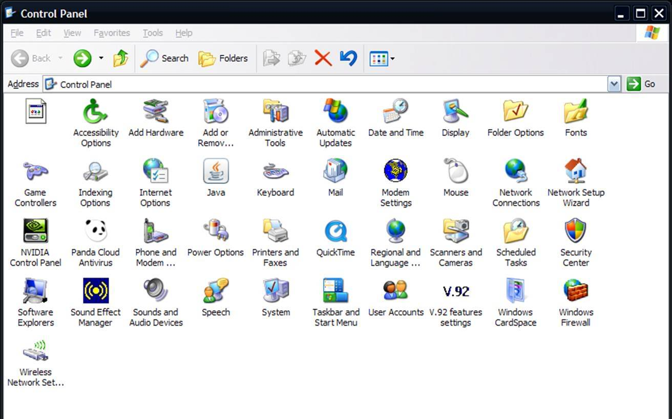



Control Panel
X
View the system information
View the Binver
control panel
Computer
Display
User
accounts
Bindows 7
For testing purposes only. Build 7351

Slide 15

Display
X
Computer
Bindows Vista Aero
Vista Classic
OK
Bindows 7
For testing purposes only. Build 7351

Slide 16

User accounts
X
Computer
Administrator
Owner
OK
Bindows 7
For testing purposes only. Build 7351

Slide 17
Up Browser - Error
X
http://www.sjaskansjkna.com
->
Computer
Up Browser cant found the solicited website
Error 404 Website/server/data/DNS not found
Bindows 7
For testing purposes only. Build 7351

Slide 18
BubbleSoft Mail
X
Welcome!
Sent by: BubbleSoft
Welcome to BubbleSoft Mail!
Welcome
Computer
Bindows 7
For testing purposes only. Build 7351

Slide 19
System Information
X
Computer
BubbleSoft Bindows Vista
Service Pack 1
Copyright © 2015 BubbleSoft & PC
OK
Bindows 7
For testing purposes only. Build 7351

Slide 20
About Bindows
X
Bindows Vista Ultimate
Copyright © 2015 BubbleSoft & PC
Computer
BubbleSoft Bindows Vista
Service Pack 1 (Build 6429)
Copyright © 2015 BubbleSoft & PC
OK
Bindows 7
For testing purposes only. Build 7351

Slide 21

Up Browser
Internet
Computer
BubbleSoft Mail
Mail
Shutdown
>
Bindows 7
For testing purposes only. Build 7351

Slide 22
Up Browser
Internet
Computer
BubbleSoft Mail
Mail
Restart
Logoff
Shutdown
>
Change user
Bindows 7
For testing purposes only. Build 7351

Slide 23
Bindows 7
Computer
Turn off your computer to save the data on the disk.
Shutdown
Cancel
Bindows 7
For testing purposes only. Build 7351

Slide 24
Logging off…
Bindows 7 Ultimate

Slide 25
Shutting down…
Bindows 7 Ultimate

